Slide 1
Space-time in the new millennium
La notion d’ESPACE-TEMPS
au début du nouveau millénaire

Slide 2
PHYSICS
STUDIES PHENOMENA AT VARIOUS SCALES
SMALL STRUCTURES
AND
LARGE STRUCTURES

Slide 3
SMALL STRUCTURES
are accurately described by
QUANTUM FIELD THEORY
which postulates
that matter is composed
out of elementary particles
mediated by exchange of other elementary particles
bound together by forces,
Notes:
Check compared to the new version

Slide 4

Interactions
FOUR INTERACTIONS ARE EXPERIMENTALLY OBSERVED:
Electromagnetic interaction binds electrons and protons:
mediated by -quanta, or photons
LIGHT is the collection of photons
Weak interaction transforms neutron into proton:
mediated by W and Z bosons
-radiation is the weak interaction process
Strong interaction binds protons and neutrons inside the nuclei:
mediated by gluons
Notes:
Slide 4 was modified

Slide 5
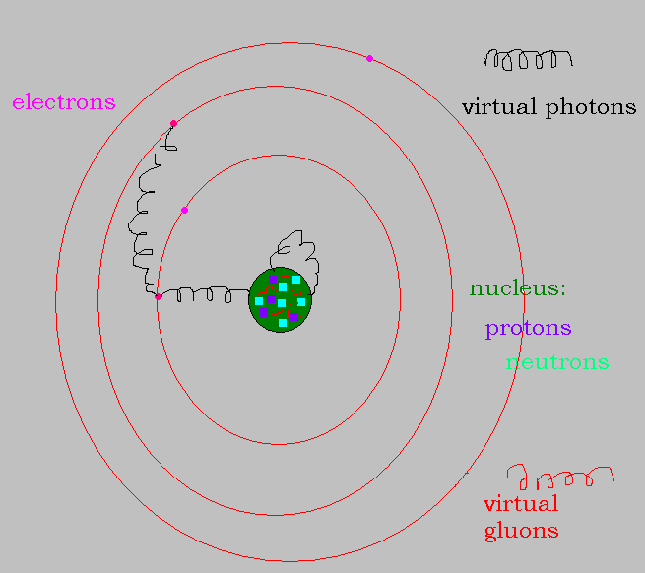
ATOM

Slide 6

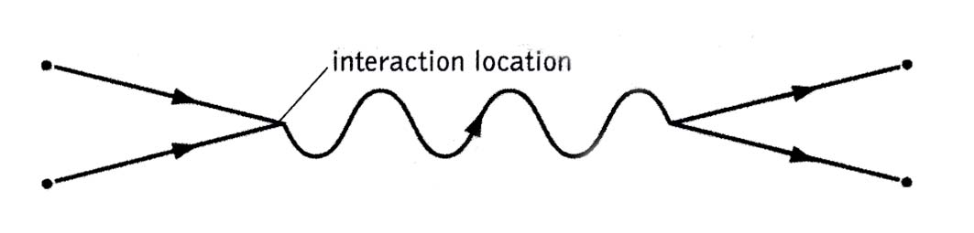
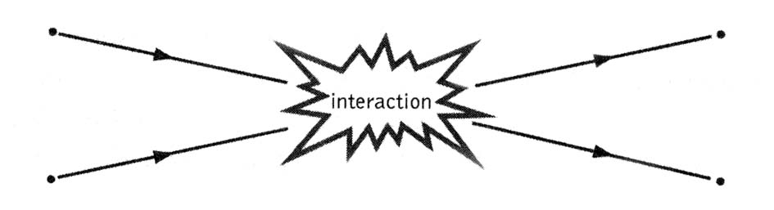
Particle interactions
TAKE PLACE IN A
FIXED SPACE-TIME BACKGROUND
THE BEST EXPERIMENTAL TESTS IN PHYSICS

Slide 7
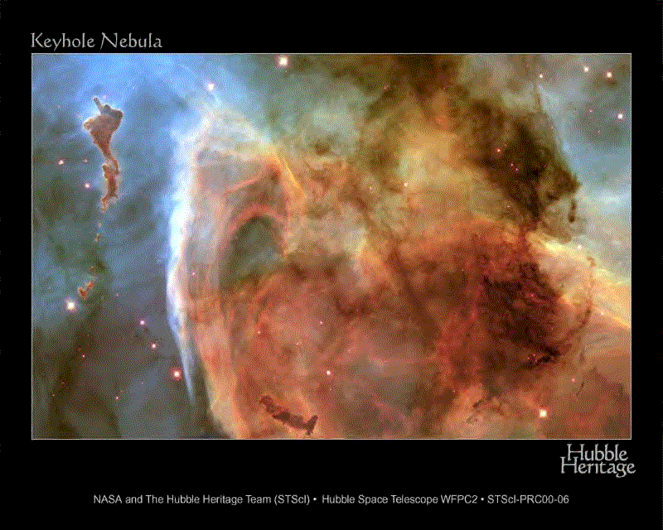
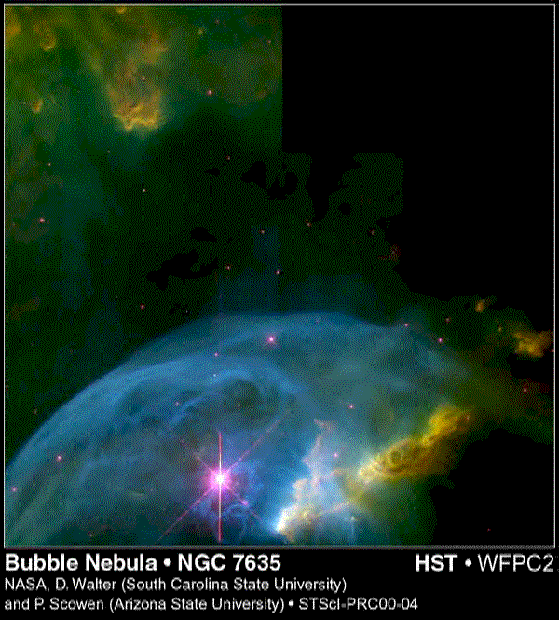
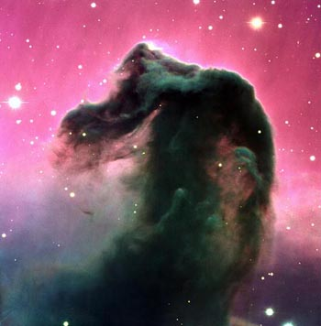
LARGE STRUCTURES
ARE THE ARENA FOR
THE THEORY OF GRAVITATION
EINSTEIN’S
GENERAL RELATIVITY
theory

Slide 8
SPACE AND TIME
In everyday life we see three spatial dimensions, and one temporal
We also think that
the GEOMETRY of SPACE
is fixed and flat
Also, we DO NOT FEEL that
our presence changes any of these.

Slide 9
ALBERT EINSTEIN SHOWED
SPACE and TIME are not independent.
Measured by different observers they mix
Any MATTER curves SPACE-TIME
Space-Time curvature is felt by any Matter
in the form of gravitational forces.

Slide 10
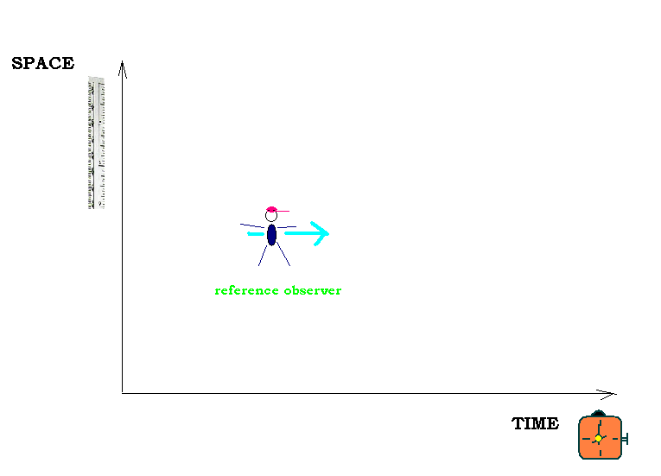
Imagine life in 1+1 dimensions

Slide 11
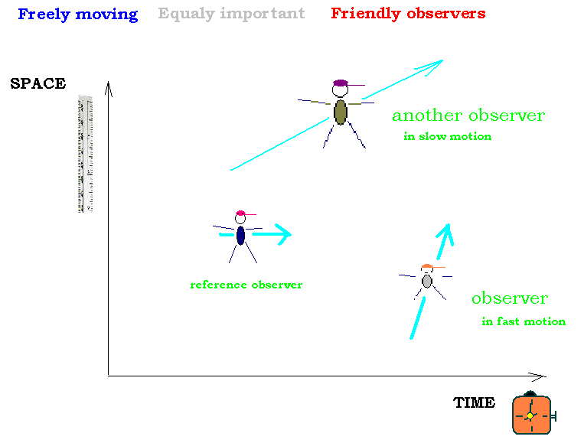
Exploring the 1+1 world

Slide 12
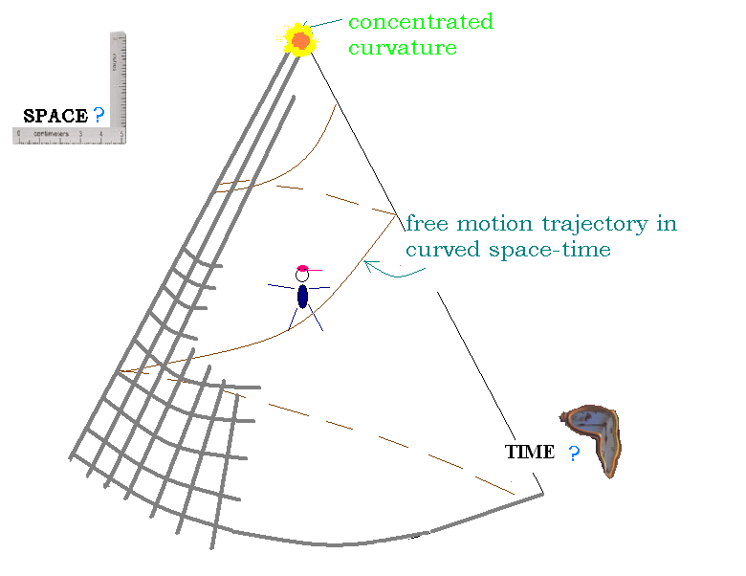
Curved space-time
Notes:
Slide 12 was removed

Slide 13
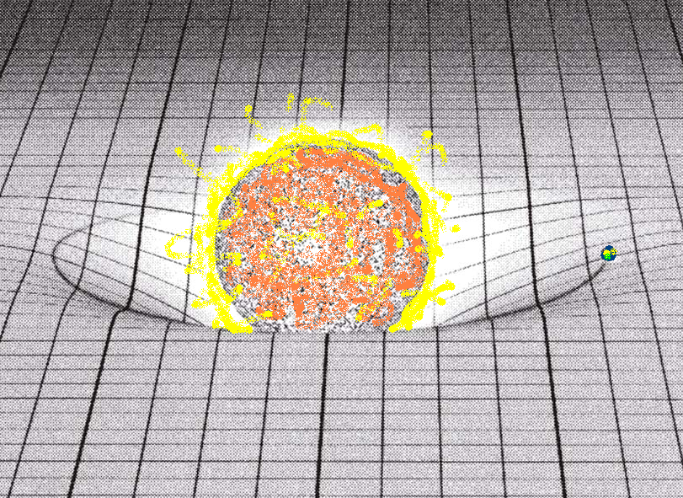
The SUN curves SPACE-TIME around it
Free motion of the EARTH proceeds around the SUN

Slide 14
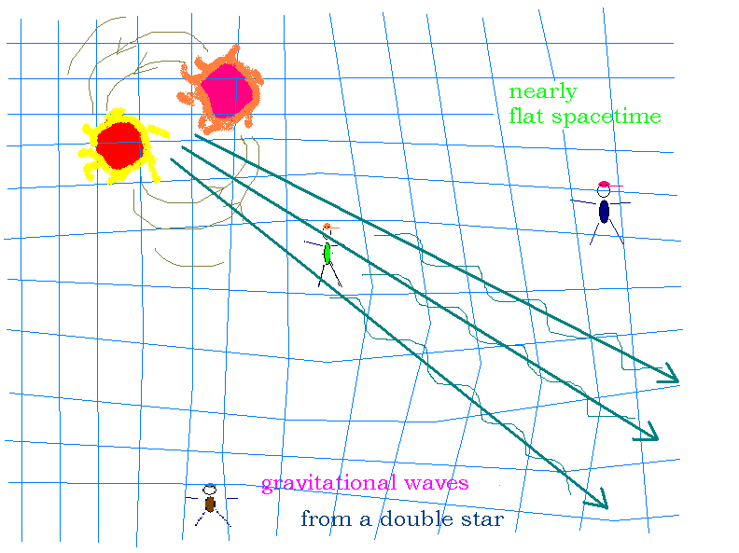
Small fluctuations of space-time fabric – gravitational waves
Notes:
Slide 14 changed the picture

Slide 15
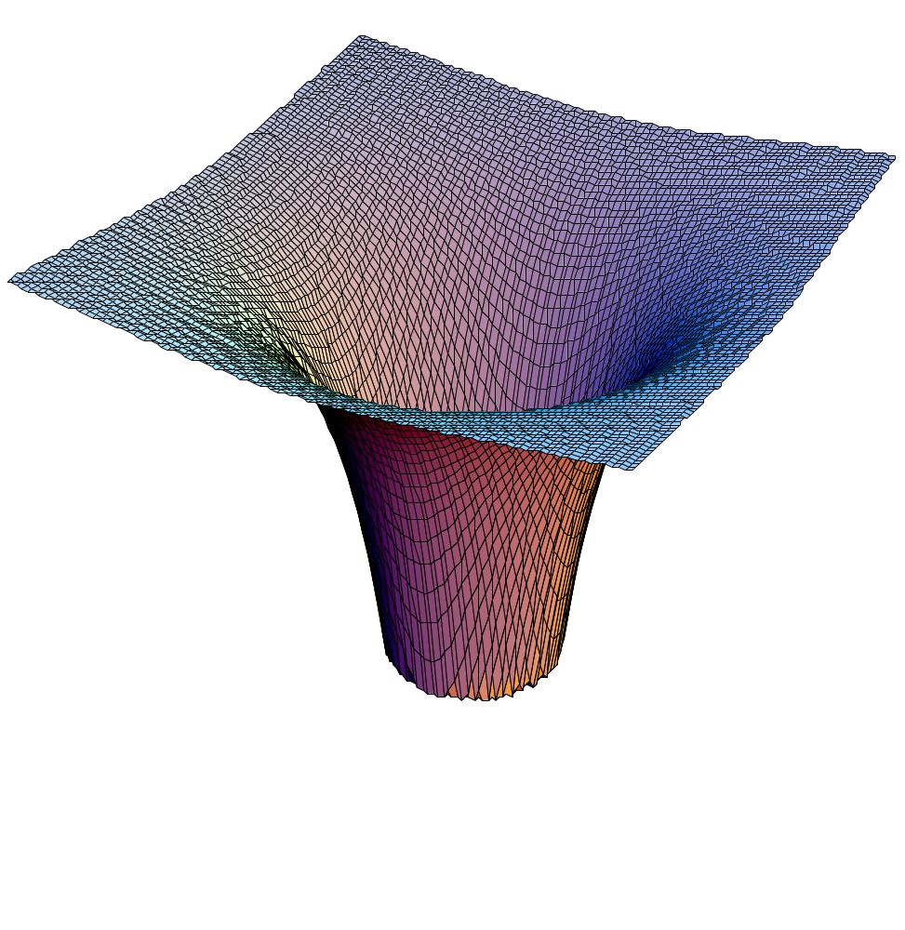
BLACK HOLES
LARGE DEVIATIONS FROM FLAT
IF A STAR IS VERY SMALL BUT MASSIVE
THEN EVEN THE LIGHT CANNOT ESCAPE ITS GRAVITATIONAL FIELD
VERY DIFFERENT FROM OUR SPACETIME
1918 Carl Schwarzschild found black hole solution in Einstein’s theory
Notes:
Slide changed

Slide 16
UNIFY IDEAS?
IS THERE A THEORY
THAT WORKS WELL
BOTH FOR SMALL AND LARGE?
Notes:
Slide changed

Slide 17
Quantum field theory
treats gravitational waves as
elementary particles – gravitons
the same interaction picture as for
the electrons and the rest

Slide 18
GRAVITATION as
Quantum Field Theory?
UNFORTUNATELY
GENERAL RELATIVITY
AS
QUANTUM FIELD THEORY
MAKES NO SENSE
Notes:
Slide changed

Slide 19
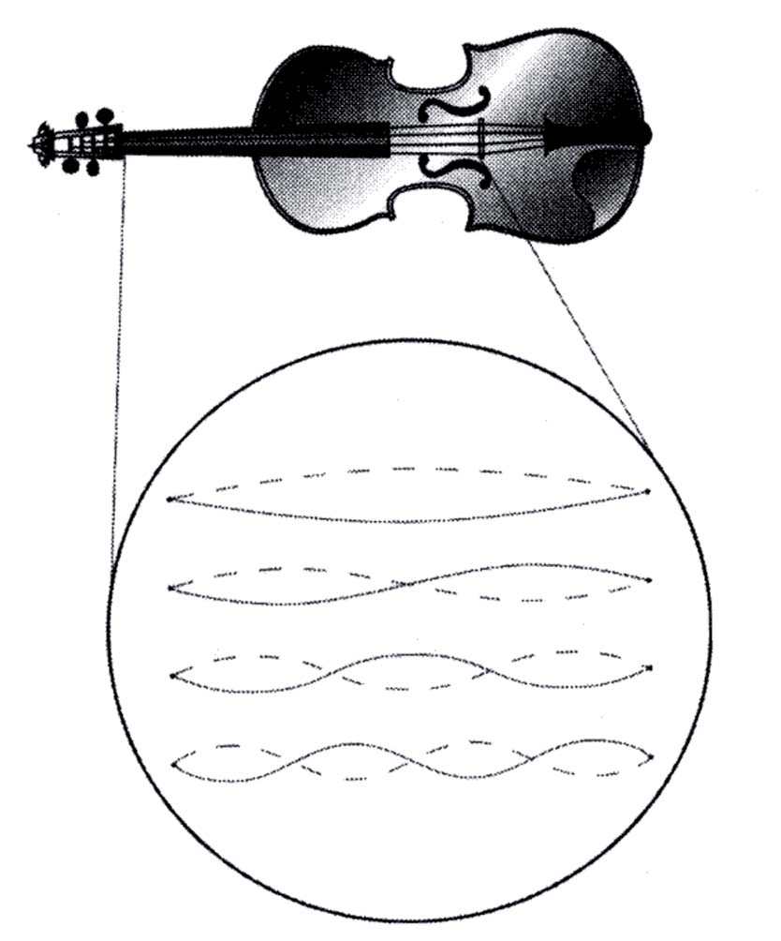
STRING THEORY
NEW IDEA FOR AN ELEMENTARY OBJECT: a STRING

Slide 20
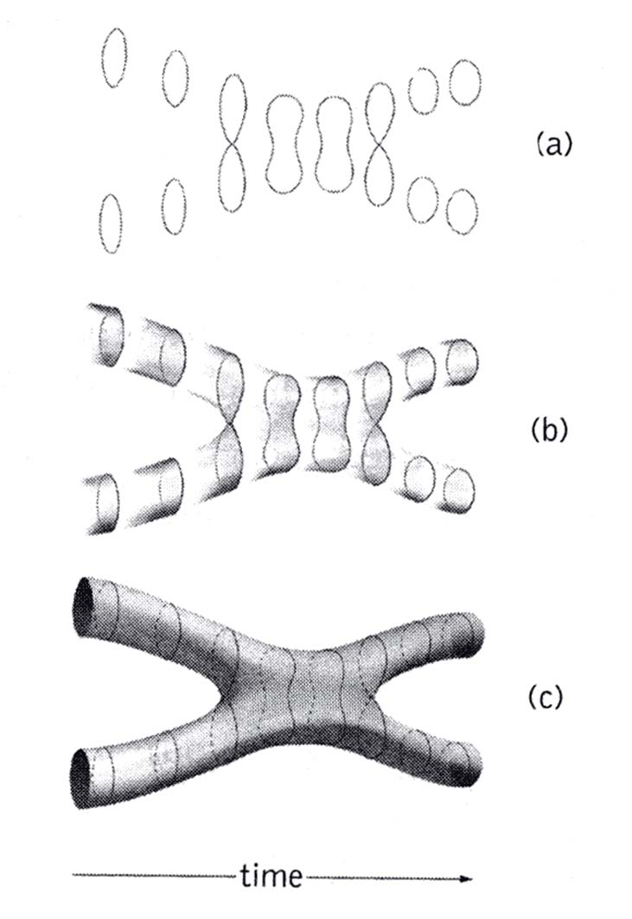
STRING TRAJECTORY
TWO DIMENSIONAL WORLDSHEET

Slide 21
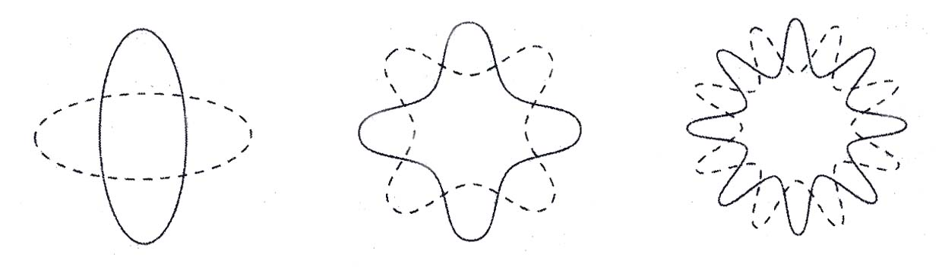
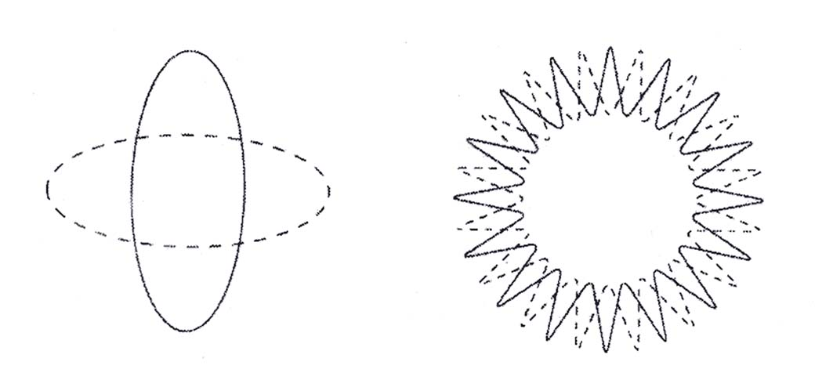
Different vibration modes
of a single STRING
look like different
PARTICLES

Slide 22
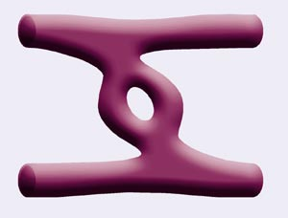
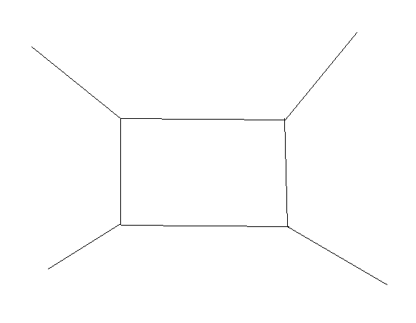
STRING INTERACTION
INSTEAD OF
STRING QUANTUM EFFECTS:
NUMBER OF HANDLES ON
THE WORLDSHEET

Slide 23
STRINGY GRAVITATION
FINITE, SOFT CORRECTIONS TO EINSTEIN’S THEORY
BUT
SPACE-TIME SHOULD BE 9+1 DIMENSIONAL !

Slide 24
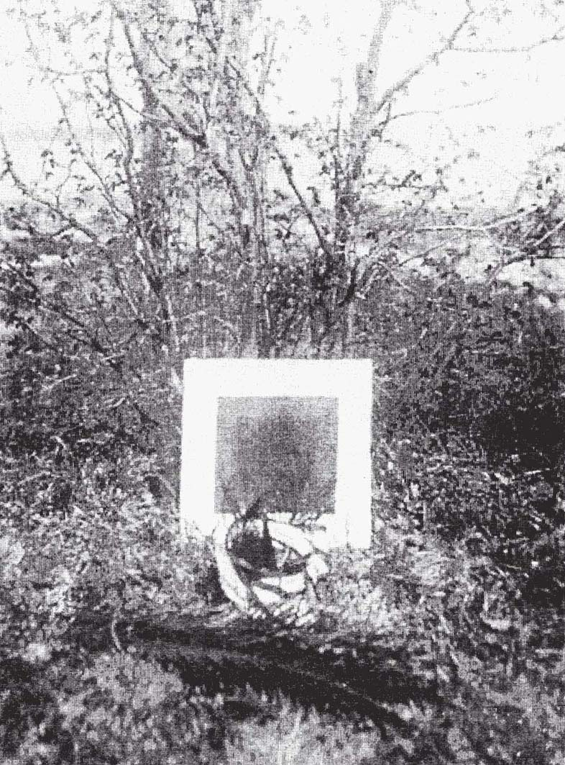

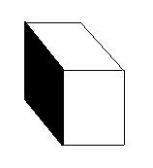
EXTRA DIMENSIONS?
Kazimir Malevich
and his Black Square
which in fact
hides a CUBE
Notes:
Slide modified

Slide 25
MALEVICH:
WHAT IS HIDDEN BEHIND THE CUBE?
1919 THEODOR KALUZA
1928 OSCAR KLEIN
PROPOSED THAT THE WORLD IS 4+1 DIMENSIONAL
THUS UNIFYING ELECTROMAGNETISM AND GRAVITY
Notes:
New slide

Slide 26
CALABI-YAU spaces
The extra 6 dimensions (9 - 3 = 6) are believed to be so SMALL that we do not observe them.
For mathematical consistency, they should be wrapped on a special kind of space :
a CALABI-YAU space.

Slide 27
BEFORE STRING THEORY
1964 - John Wheeler (Princeton) suggested that at the Planck distances
L_{Planck}=10⁻³³cm
the quantum gravity effects are so large that
the geometry and topology of space-time fluctuate as mad
1978 - Stephen Hawking (Cambridge) has explored this idea more
quantitatively and gave a name to the fluctuating space-time:
Notes:
Slide changed

Slide 28
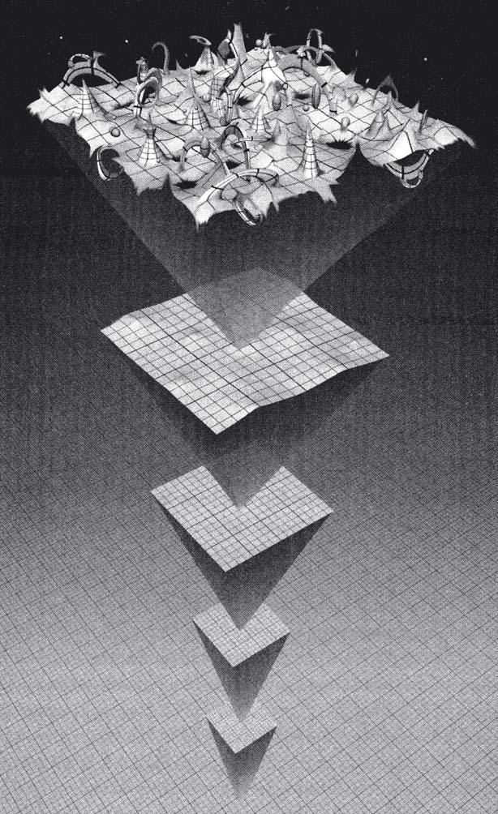
QUANTUM SPACE-TIME FOAM
1957 Boris Vian ``L’ecume des jours’’ --- time foam

Slide 29
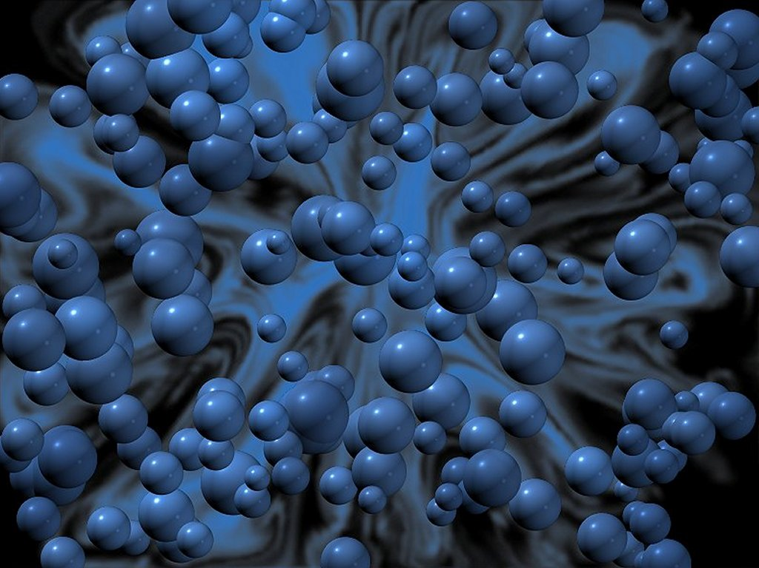
SPACE-TIME FOAM
HAWKING ARGUED
THAT AT THE PLANCK DISTANCES
SMALL , PLANCK-SIZED BLACK HOLES
POP OUT OF VACUUM AND DISAPPEAR WITHIN
PLANCK TIME : 10⁻⁴³ sec
Notes:
Slide changed

Slide 30
QUESTION
CAN STRING THEORY DESCRIBE the QUANTUM SPACE-TIME FOAM?
Notes:
Slide changed

Slide 31
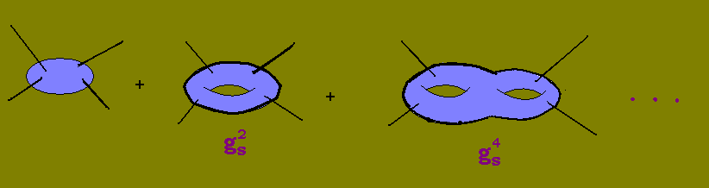
QUANTUM STRING: EXPANSION IN THE NUMBER OF HANDLES
GRAVITON SCATTERING DONE IN A STRINGY WAY
g_{s}
STRING COUPLING CONSTANT
Notes:
Slide changed

Slide 32
IMPOSSIBLE to see BLACK HOLES
WORKING WITH FINITE STRING PRECISTION:
FINITE NUMBER OF HANDLES
SMALL DEVIATION OF FLAT GEOMETRY
FINITE NUMBER OF GRAVITONS

Slide 33
SIMPLEST STRING THEORIES with infinite number of handles under control:
TOPOLOGICAL STRINGS
COUNT HOLOMORPHIC CURVES ON CALABI-YAU MANIFOLDS
MATHEMATICALLY WELL-FOUNDED:
GROMOV-WITTEN THEORY, BASED ON KONTSEVICH IDEAS OF STABLE MAPS
Notes:
Slide changed

Slide 34
FROM STRINGS TO CRYSTALS
LAST YEAR,
DURING
THE FIRST SIMONS WORKSHOP
AT STONY BROOK
Andrei Okounkov(Princeton), Nikolai Reshetikhin(Berkeley) and Cumrun Vafa(Harvard)
HAVE FOUND THAT:

Slide 35
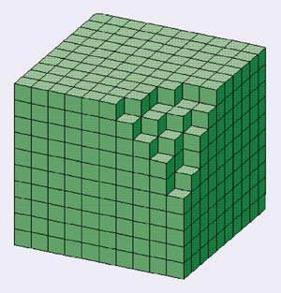
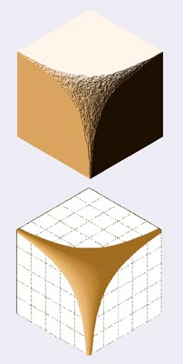
TOPOLOGICAL STRING KNOWS ABOUT MELTING CRYSTALS!!!

Slide 36
DICTIONARY
GEOMETRY OF THE ORIGINAL CRYSTAL
corresponds to the
GEOMETRY OF CALABI-YAU MANIFOLD
STRING COUPLING g_{S}
corresponds to the
INVERSE ABSOLUTE TEMPERATURE

Slide 37
THIS RELATION WAS
EXPLAINED MATHEMATICALLY
IN DECEMBER 2003
Davesh Maulik(Princeton),
Nikita Nekrasov (IHES),
Andrei Okounkov(Princeton) and
Rahul Pandaripande(Princeton)

Slide 38
MOST INTERESTING:
PHYSICS OF THIS CORRESPONDENCE
MELTING CRYSTAL = FLUCTUATING CALABI-YAU GEOMETRY
BOXES (ATOMS OF THE CRYSTAL)
= THE SPACE-TIME FOAM BUBBLES
= HAWKING’S VIRTUAL BLACK HOLES
Amer Iqbal (Harvard), Nikita Nekrasov (IHES),
Andrei Okounkov (Princeton), Cumrun Vafa (Harvard), building
on ideas of the earlier work by NN and Harry Braden (Edinburgh)

Slide 39
THEREFORE
STRING THEORY CAN DESCRIBE the QUANTUM SPACE-TIME FOAM

Slide 40
FOR THE NEXT MILLENIUM
QUANTUM GRAVITY
EFFECTS IN MORE REALISTIC
STRING THEORY
UNIFICATION OF (QUANTUM) GRAVITIES:
Loop Gravity
Noncommutative SPACE-TIME
Cosmological billiards
…

Slide 41
In preparing this lecture the pictures from the following publications were used :
REFERENCES
“The elegant universe”, by B.Greene
“The paths to paradise”, by P.Kornel
“Quantum foam and topological strings”,
by A.Iqbal, N.Nekrasov, A.Okounkov and C.Vafa
Hubble telescope pictures, NASA
“Space goes quantum at Stony”, by G.Sterman and M.Rocek

